Slide 1
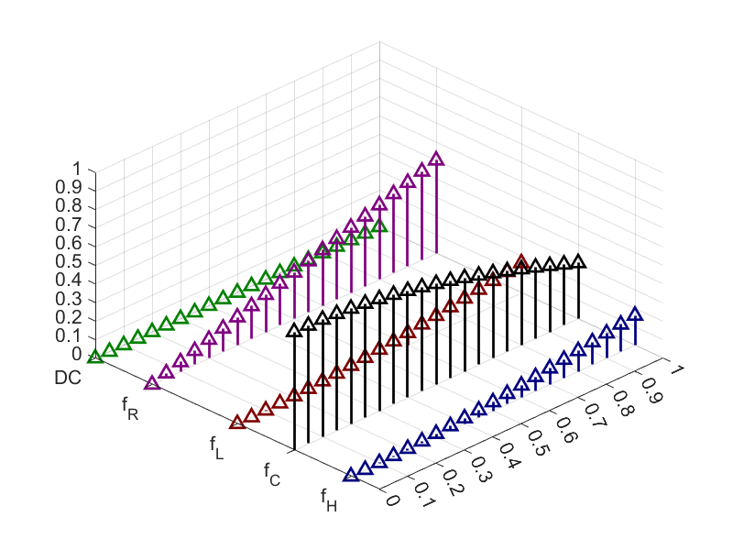
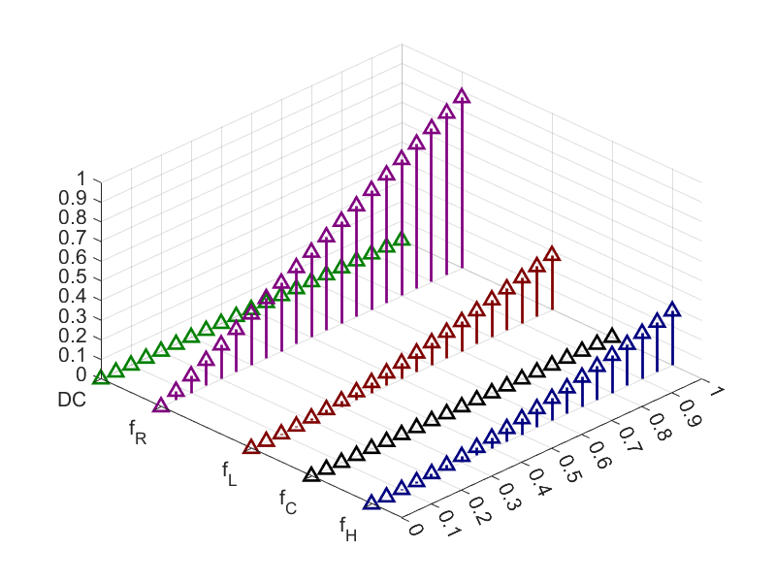
Frequency
Modulation Index
Frequency
Modulation Index
(a)
(b)

Slide 2
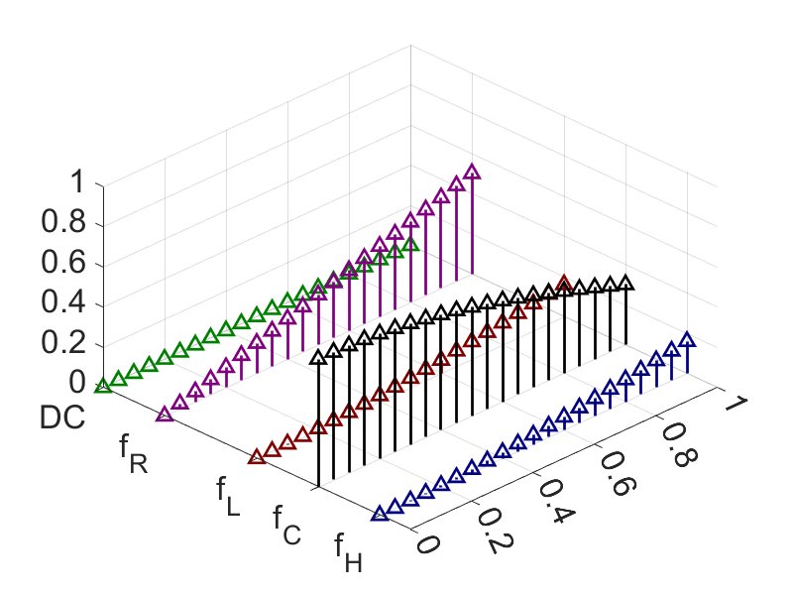
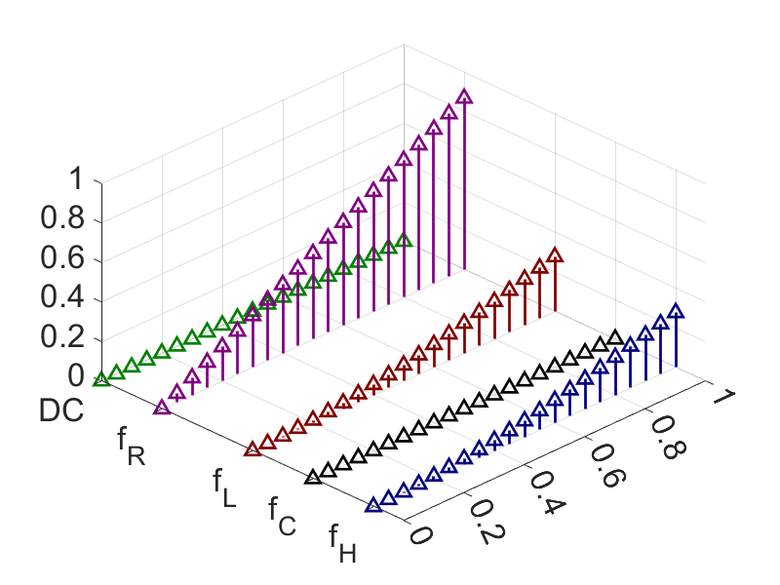
Modulation
Index
Modulation
Index
Frequency
Frequency
(a)
(b)

